Slide 1


Components 101
PMI Portland
Dianne Johnson, Past President
Updated June 2012
Notes:
The Essential Guide to PMI – Chapter Volunteer Must-Knows
Chapter Volunteer Need to Knows; Knowing PMI and Maximizing Chapter Volunteering;
PMI Central: Chapter Volunteer Resources and Information

Slide 2
What We Are Going to Talk About
PMI Global
Region 1
Resources
PMI Portland
Ethics

Slide 3
PMI is…
One of the largest professional associations in the world
  Over half a million members and credential holders in almost 200 countries
  260 geographic chapters, 36 communities of practice
Global standards and credentials
  12 standards for project management created by working professionals
  5 credentials recognized and valued worldwide
Training and accreditation
Research and publications
Notes:
-PMI has been driven by practitioners’ needs since 1969, when it was formed by five working project managers to advance the profession by sharing knowledge and experience. Today, with more than 330,000 members and 420,000 PMI credential holders, it is one of the world’s largest and fastest-growing professional associations.
Members share expertise and experience at chapter events. There are 255 chartered chapters in 185 countries as well as regional, national and global events. Those with specialized interests often join online communities of practice to dig deeper into a specific industry or aspect of project management.
Members also develop and update PMI’s professional standards as well as the exams applicants take to earn PMI credentials. Almost 1000 members worked over nearly two years to produce the fourth edition of the PMBOK® Guide.
Many PMI chapters offer training towards certification, as do many hundreds of REPS (Registered Education Providers). In addition, PMI sponsors research and holds conferences to add to the profession’s stock of knowledge and good practices.
PMI’s credentials would not exist without the thousands of volunteer hours provided by project managers throughout the world who ensure balanced representation in the structure and content of the credential examinations. Each year, these volunteers work with PMI to create examination questions, rigorously review these questions, and refine PMI’s certifications. They also oversee PMI’s certification program and drive change initiatives. Representing PMI’s diverse stakeholders – PMI’s volunteers come from every area of the globe and represent many industries, experiences, and backgrounds.
PMI certifications reflect best practices in the discipline of project management, not any one standard or industry. This provides better transferability between organizations and industries. Practitioners can get a PMI certification and have confidence that it provides a baseline recognized in a variety of organizations, industries, and methodological approaches. Furthermore, because PMI maintains such rigorous practices to keep its certification program relevant and validated, you never have to worry about a PMI certification becoming obsolete.
PMI’s certification program is designed to ensure that all certification holders have demonstrated their competence through fair and valid measures. One of the ways in which this is implemented is through a scenario-based multiple choice examination format, which is a highly reliable way to assess project management competence. PMI uses highly reputable testing organizations to obtain third-party validation of this program. Unlike interviews and essays, which are not reliable and can be influenced by many factors other than the test taker’s professional background, PMI’s program reflects a methodology used by most world-class licensing organizations, such as nursing, architecture, and engineering.

Slide 4
PMI Envisioned Goal
Worldwide, organizations will embrace, value, and utilize project management and attribute their success to it.
Notes:
4
Our core purpose, our mission, is why we came together. The values are what we believe - they guide how we act and influence the expectations of our stakeholders. Our envisioned goal – our vision for the future – is what we want to accomplish – what we view currently as the measure of our ultimate success. While many organizations would include something about themselves in their vision, our envisioned goal is about our profession and the value it delivers, rather than directly about PMI. However, we truly believe that the interests of PMI are directly connected to the interests of the profession.

Slide 5
PMI Core Purpose:
To advance the practice, science and profession of project management throughout the world in a conscious and proactive manner.

Slide 6

PMI Value Proposition
PMI’s Differentiation Strategy in the Marketplace
Be the Eminent Influence
for the advancement and success
of project management
in all markets
throughout the world
Notes:
6
The Value Proposition describes our nearer term focus – it describes how we need to differentiate ourselves in the marketplace in order to make progress on our Strategic Plan. Eminent Influence has been established as the Institute’s appropriate Value Proposition for all of its markets. While identifying eminent influence as a key differentiator for ourselves, we need also to be excellent in product development, customer service, and cost management.

Slide 7
PMI Core Values: PMI’s Essential and Enduring Guiding Principles
At PMI we believe in
  Project Management Impact
  Volunteerism
  Professionalism
  Community
  Engagement
Notes:
PMI is driven by a clear mission and an underlying set of values that guide how we act and influence the expectations of our stakeholders. Even as a diverse organization, we share a common set of values. Our core values are not subject to changes in the association and business environment or dictated by trends in organization management. These values are fundamental and deeply held.
As part of our Core Ideology, PMI’s Five Core Values are enduring and are guiding principles upon which we act.
At PMI we believe in:
Project Management Impact - Project management is a critical competence that has a positive influence on organization results and society.
Professionalism - Accountability and ethical behaviour ensures our commitment to PMI stakeholders.
Volunteerism - Volunteers and effective volunteer partnerships with staff are the best way to accomplish the Institute’s goals and objectives.
Community - Bringing members of the global project management community together is the best way to facilitate their growth and advance the project management profession.
Engagement - Encouraging diverse viewpoints and enabling individuals to contribute to the project management profession and to the Institute.

Slide 9
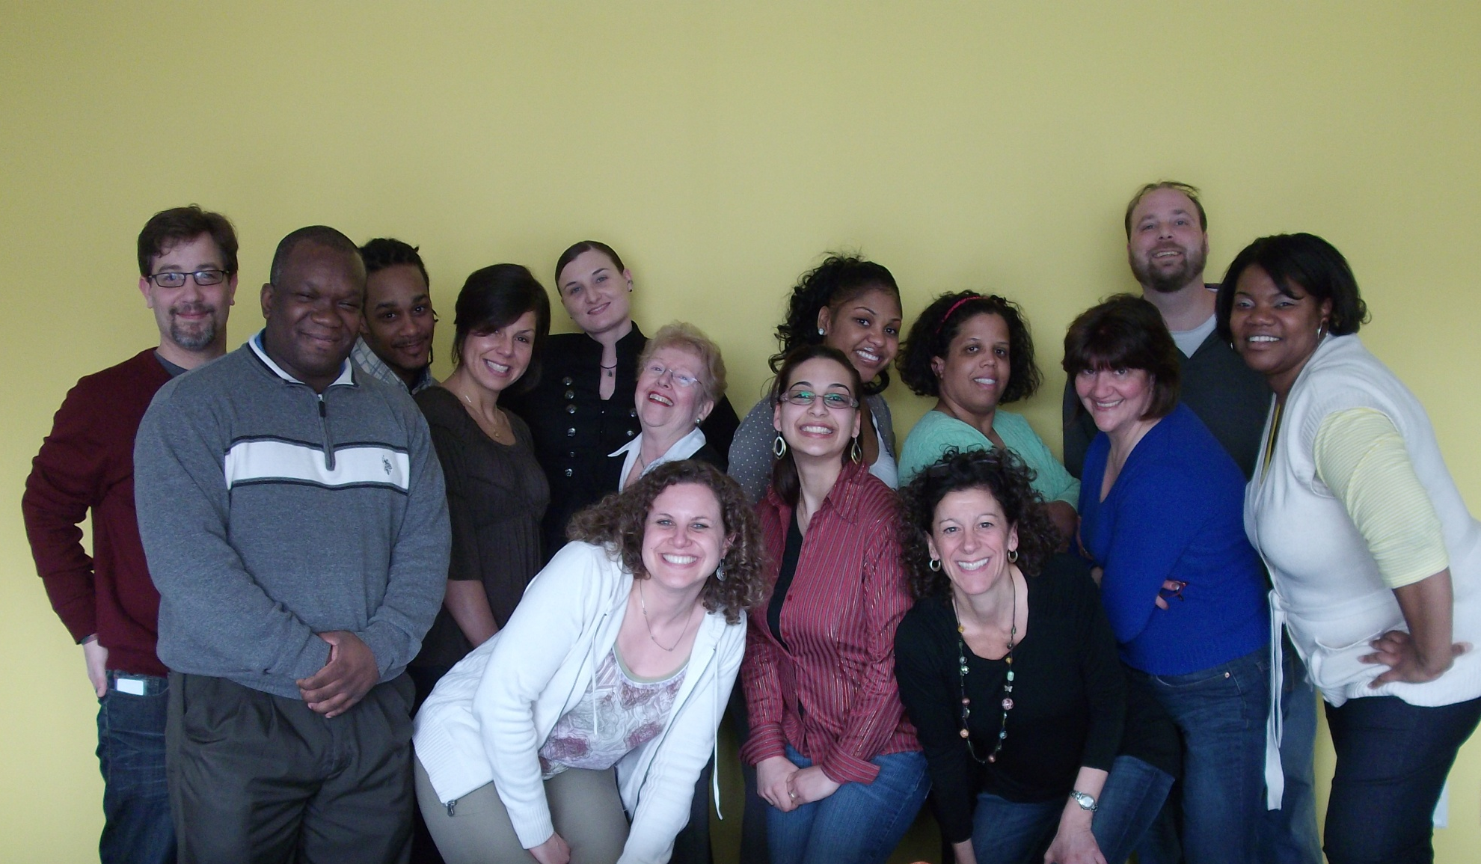
Chapter and Volunteer Support Staff
Darryl Jackson
Drew Ihlenfeld
Gil Marder
Iesha Brown
Anne Jenemann
Notes:
Left to right – Gil Marder (Leadership Institute Meetings); Bernard Smith (Communities of Practice Administrator); Darryl Jackson (Chapter Administrator); Rebecca Anderson (Member and Volunteer Relations Administrator); Danielle Ritter (Supervisor to Chapter Administrators); Anne Jenemann (Chapter Administrator); Nancy Berger (Chapter Administrator) Philomena (Nina) Aiuto (Community Development Associate); April Burton (Chapter Administrator); Joanne Lynch (Manager. Leadership Institute); Leasella (Lea) Owens (Communities of Practice Administrator); Judy Brennan (Leadership Institute Planner Cla; Drew Ihlenfeld (Chapter Administrator); Iesha Brown (Manager, Community Development).
Not Pictured – Nichole Ritz (Communities of Practice Administrator)
Who to call list on Community Development Leadership site

Slide 10
PMI Communities of Practice
Network and build knowledge in the virtual world
Exclusively available to PMI members, our communities of practice are interactive places for you to meet online, discuss ideas and build the profession’s body of knowledge.
Participate in as many communities as you like. The more you get involved, the more you’ll enjoy your PMI membership.
38 Communities of Practice
Notes:
Aerospace and Defense
Agile
Automation Systems
China Project Management
Construction Industry
Consulting
Earned Value Management
eBusiness
Energy, Oil, Gas and Petrochemical
Entertainment
Ethics in Project Management
Financial Services Industry
Global Diversity
Global Sustainability
Government
Healthcare
Human Resource Project Management
Information Systems
Innovation and New Product Development
International Development
IT and Telecom
Leadership in Project Management
Learning, Education and Development
Legal Project Management
Marketing and Sales
New Practitioners
Organizational Project Management
Pharmaceutical
Program Management Office
Project Management Quality
Project Risk Management
Requirements Management
Retail
Scheduling
Service and Outsourcing
Transportation
Troubled Projects
Utility Industry

Slide 11
PMI Chapters
Chapters are separate legal entities delivering member value through programs and services.
Community Development department supports chapter and volunteer leaders to form, build and maintain chapters.
Network of volunteer, staff, technical and informational resources.
Notes:
Chapter business/operation plans should be aligned with PMI strategy.
268 Potential and Chartered Chapters
159 North America
51 EMEA
29 Asia-Pacific
29 Latin America
36 Communities of Practice
Approximately 200 CoP Leaders
Approximately 3,148 Chapter Leaders

Slide 12
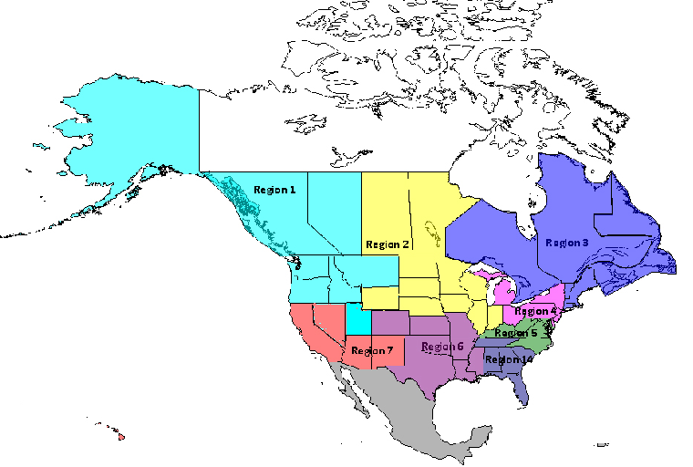
PMI Regions (USA)
16 Chapters
2 with Branches
12

Slide 13
PMI Region Mentors
PMI Began Managing Program in 2004
Program charter and job description updated yearly
Extensive application process:
  PMI.org volunteer form and criteria review
  Mentor program application
  Interview with management
Region budgets and action plans
Notes:
Charter posted under Shared Documents > Toolkit folder > Component Mentor Program folder on Community Leadership site
Each mentor signs COI and confidentiality agreement yearly. Upon agreeing to role, volunteers agree to comply with volunteer code of conduct.
Look for this role and other volunteer opportunities on pmi.org > Get Involved
To learn more about this role and other volunteer opportunities, e-mail volunteer@pmi.org

Slide 14
Region 1 Mission:
Achieve the advancement of chapter maturity through the collaboration and education of Region 1 Leaders’ knowledge, tools, and processes and influence PMI Global Operations Center (GOC) evolution of the same. Region 1 includes components from Alaska, Western Canada, Idaho, Montana, Oregon, Utah and Washington.

Slide 15
Region 1 Chapters
Alaska - Alaska Chapter
Canada - Canadian West Coast Chapter
Canada - Northern Alberta Chapter
Canada - Southern Alberta Chapter
Canada - Vancouver Island Chapter
Idaho - Eastern Idaho Chapter
Idaho - Western Idaho Chapter
Montana - Montana Chapter & Branches
Oregon - Portland Chapter
Oregon - Willamette Valley Chapter & Branches
Utah - Northern Utah Chapter
Washington - Columbia River Basin Chapter
Washington – Inland Northwest Chapter
Washington - Mt. Baker Chapter
Washington - Olympia Washington Chapter
Washington - Puget Sound Chapter

Slide 16
Resources in the Region
Region 1 Site http://region1.vc.pmi.org
  Contains information specific to Region 1
    Region Information. e.g. Minutes from Presidents’ teleconferences
    Sample documents and templates from Chapters
    Chapter specific folders for maintaining Board documentation if desired
    Online Discussions
    Region 1 Leadership Meeting Documents
    Surveys
16

Slide 17
Leadership Institute
“…..thru its unique offerings of volunteer engagement opportunities and services, and robust leadership development programs, supports PMI‘s strategic objective of advancing the project management profession on a global
  Leadership Institute Meetings
  Leadership Institute Master Class
  PMI Learn – Volunteer Development Center
  Volunteer Relations
  Leadership Institute Volunteer Planning Meeting

Slide 18
Additional Programs and Services
Community Awards Program
  30 April 2011 Deadline
  Volunteer Awards Committee Review
Chapter Milestone Program
  Recognizes & Awards Anniversary of Charter Date
Chapter Tradeshow Support
  Booth Rental for Major Meetings
Speaker Engagement Request Form
  Board/Executive Speakers
  At Least 10 Weeks Prior
Notes:
Awards Program
- Annual Charter Renewal must be received by PMI by the designated 31 March 2011deadline
- Community must meet all “minimum component performance criteria” as outlined in the annual Charter Renewal and be in good standing with the Project Management Institute (PMI) for the period covered by the nomination.
- Component must be chartered for one or more calendar years
- Contact:
Anne Jenemann
Chapter Administrator
610/356/4600 extension 5035
anne.jenemann@pmi.org
Chapter Milestone Program
- An improved program with focus on the way PMI recognizes and awards chapter tenure. The chapters that have achieved milestones this year will be recognized in alignment with this new and improved program.
- 5 Years Tablecloth; 10 years Brandstand; 20 years Deluxe Tablecloth; 25 years Lapel Pins; 30 years $3,000 honorarium and CEO video; 35 years $5,000 honorarium and CEO video
-Contact chaptersupport@pmi.org for further information.
Chapter Tradeshow Support
- The Chapter Tradeshow booth is a resource which is valuable to the chapter when participating in symposiums or professional project management events
The Chapter Tradeshow Support Form is available on the Community Leadership Community Site > Share > Links. http://leadership.vc.pmi.org/Share/Links.aspx A direct link to the form is: http://componentleadership.pmi.org/pmihq/Marketing%20Dept/request_for_pmi_components_trade.htm
Speaker Engagement Requests
- The form is located on PMI’s website on the Board of Directors’ page. For your convenience, here is the link to this form: http://www.pmi.org/en/About-Us/Forms-Speaking-Engagement.aspx. When the SER is received by the Event Speaker Administrator (ESA) at PMI’s Global Operations Center, the engagement process begins.

Slide 19
Technical Tools and Resources
Community Leadership Site
  Access Based on Component System
  Best Practices, Blogs, Discussions, Guides, News, Links to Forms/Services, Policies, Templates, Webinars
Region Leadership Site
  Mentor and Volunteers Manage Content
Component System (CS)
  President/Past President Update Officers/Volunteers
  Friday Facts Mailing List from CS
Date Exchange Program (DEP) in CS
  Real time and month-end membership reports
  Support/FAQs
Notes:
Community Leadership site - The primary portal for PMI leaders to access information to support the development and administration of their PMI community. We strongly encourage all community leaders to become familiar with this site.
Community Leadership Site
Meeting Information
- Dates, locations and links to meeting Web sites
Current News
- Most recent HQ communications
- Updated information on component products/ services
Online Forms
- Speaker Request Form
Resources for Officers
- Resources are grouped by officer title
Officer Planning Calendar
- Leadership Meeting dates and important deadlines
Communications Section
- Friday Facts
- Component Statistics
Consult chapter administrators for further information on access and use to Community Leadership site and Component System

Slide 20
PMI Volunteer Resources and Contacts
PMI Strategic Plan; Governing Documents; Policies & Agreements - http://www.pmi.org/About-Us/Governance.aspx
PMI Membership At Large Chart http://www.pmi.org/About-Us/~/media/PDF/Governance/membershipatlarge.ashx
Speaking Engagement Requests - http://www.pmi.org/About-Us/Forms-Speaking-Engagement.aspx
Community Leadership Site Link - http://leadership.vc.pmi.org
Leadership Site Links - http://leadership.vc.pmi.org/Share/Documents.aspx (Click on Toolkit and Basic Tools folder)
Component System - http://components.pmi.org/
Region 1 Site Link - http://region1.vc.pmi.org
Notes:
PMI Volunteer Resources and Operations

Slide 21
PMI Volunteer Resources and Contacts
Who to Call List - http://leadership.vc.pmi.org/Share/Documents.aspx (Click on Toolkit and Basic Tools folder)
General Chapter Inquires – chaptersupport@pmi.org
Community Formation/Re-Organization – communityformation@pmi.org
PMI Marketing Portal - www.pmi.org/MarketingPortal
Chapter Tradeshow Form - http://componentleadership.pmi.org/pmihq/Marketing%20Dept/request_for_pmi_components_trade.htm
AdobeConnect Webinar Request Form - http://leadership.vc.pmi.org/Webinars.aspx
Notes:
PMI Volunteer Resources and Operations

Slide 22
Chapter Maintenance and Administration
  PMI Insurance Program
    Event
    Officer and Director
  Group Tax Exempt Program
  VoteNet
  SurveyMonkey
  AdobeConnect Webinar
Notes:
PMI Insurance Program
- Reference Chapter Policy Manual and Community Leadership site.
- Umbrella plan that covers general liability and directors/officers.
- PMI can deduct the US$200.00 insurance payment from a chapter’s dues transaction. The chapter must make this request in writing to their Chapter Administrator.
- PMI GOC subsidizes coverage for new chapters and those with limited financial resources.
Group Tax Exempt Program - All PMI chapters must seek tax exemption as 501 (c) (6) organizations.
- Program applies to US formed chapters only.
- No separate determination of tax-exempt status from the IRS.
- Tax-exempt determination from the IRS as a 501 C 6 tax-exempt organization.
- The Component’s board of directors authorized participation in the group exemption program.
- Fiscal year runs from January 1 to December 31, as required by the Internal Revenue Service.
Consult Chapter Administrator on VoteNet, SurveyMonkey, and AdobeConnect implementation.

Slide 23
Board Leadership
Boards have authority and accountability
  Financial oversight
  Risk management
  Program monitoring and evaluation
  Legal and ethical oversight
Size and composition
  No magic number
  Alignment and consistency
  Offer diversity, knowledge and skills
  Committees need not be filled or chaired by board members
23

Slide 24
Board Leadership
Orientation and Succession Plans
  Mentoring / Coaching
  Balanced board terms to ensure continuity but allow for new ideas and growth
  Plan for succession in the next board and committees
  Start grooming your replacement today
24
Notes:
24

Slide 25
PMI Portland Board Structure

Slide 26
Ethics
Code of Conduct
Conflict of Interest

Slide 27
PMI Code of Ethics & Professional Conduct
Four Areas:
  Honesty
  Fairness
  Respect
  Responsibility
27

Slide 28
Conflict of Interest
Conflicts of interest may result from:
  corporate or company, personal or family business interests and relationships that may involve or relate to PMI in any way
You must disclose the existence of conflict
28

Slide 29
Conflict of Interest
Possible remedies for conflict
  Recusal from all decision making
  Recusal from specific area of decision where conflict exists
  Replacement of officer or board or committee member
  Participation as a subject matter expert but not in discussion or deliberations
29

Slide 30
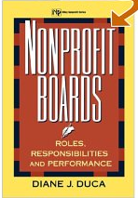
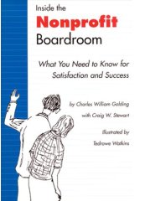

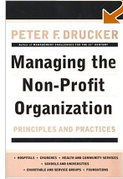
Consider Getting Educated as a Board Member
Non-profit Boards: Roles, Responsibilities, and Performance
by Diane J. Duca (Author)
Inside the Non-profit Boardroom
by Charles William Golding, Craig Stewart, Tedrowe Watkins, Anne M. Will, Craig W. Stewart
Secrets of Successful Boards: The Best from the Non-Profit Pros
by Carol Weisman (Editor), Sandy Sineff (Illustrator)
Managing the Non-Profit Organization: Principles and Practices
by Peter F. Drucker (Author)
30

Slide 31
Thank You!
For your time
  For your attention
    For you enthusiasm
      For your support
To continue to make PMI Portland a Standout Chapter
Good Luck and Have Fun this Year!

